Slide 1
Digital Communication 24EC2208
Digital Carrier Modulation

Slide 2
Binary Phase Shift Keying (BPSK)

Slide 3
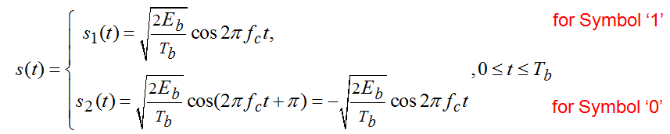
Binary Phase-shift keying (BPSK)
Phase-shift keying (PSK) is another form of angle-modulated, constant-amplitude digital modulation.
BPSK is a form of square-wave modulation of a continuous wave (CW) signal.
Vary the phase shift of the carrier signal to represent digital data.

Slide 4
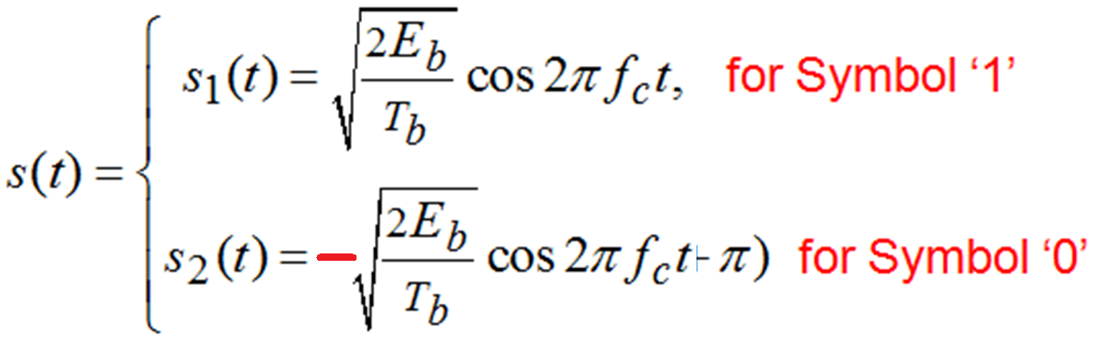
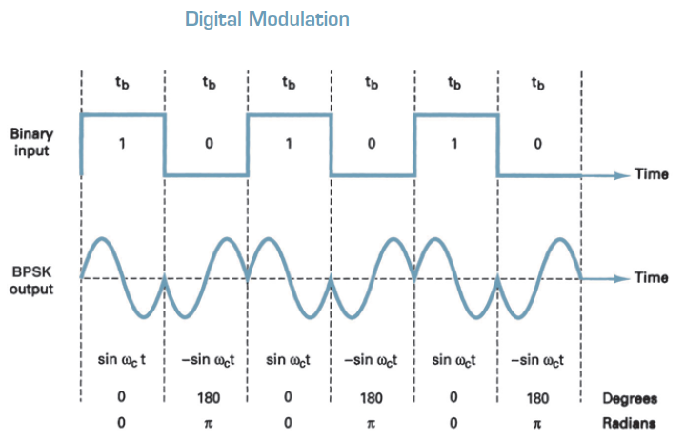

Slide 5
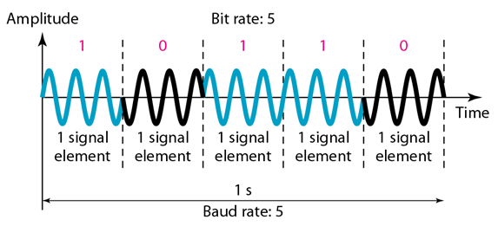

Slide 6
Signal Space for BPSK
Two orthogonal basis functions are required for BFSK

Slide 7
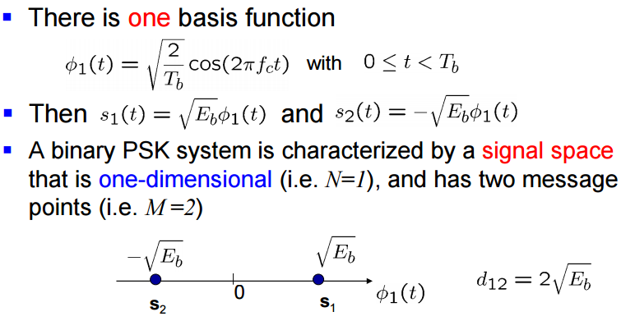


Slide 8
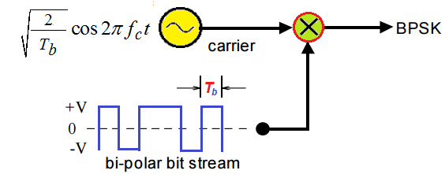
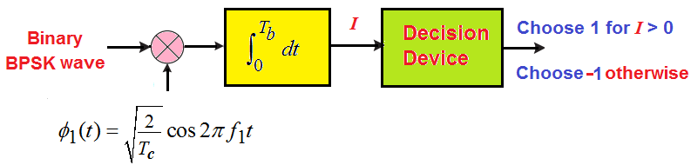

Slide 9
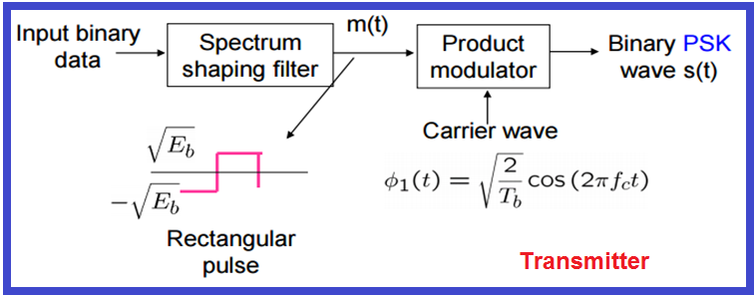
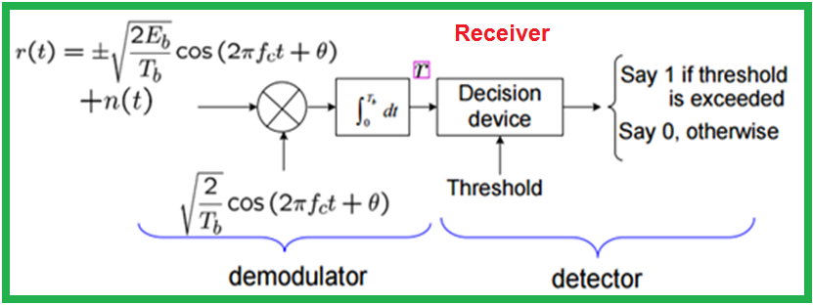
BPSK Transmitter and Receiver

Slide 10
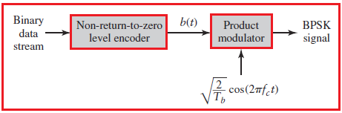
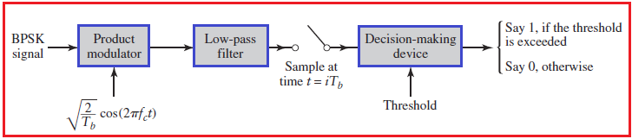
BPSK Transmitter and Receiver Moher

Slide 11
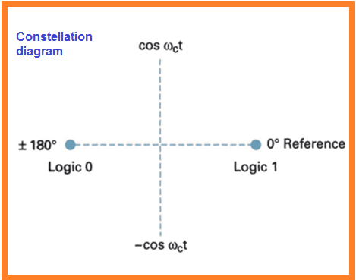
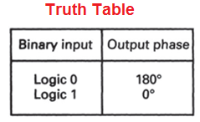
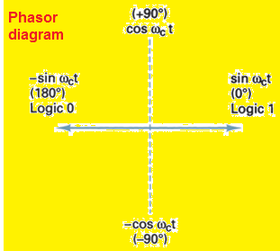
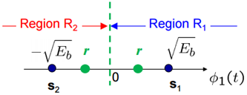

Slide 12
Bit Error Rate for BPSK
The average probability of error

Slide 13
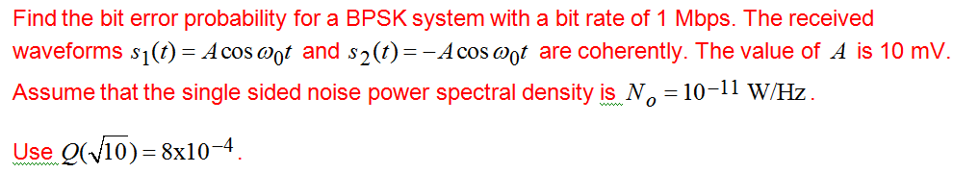

Slide 14
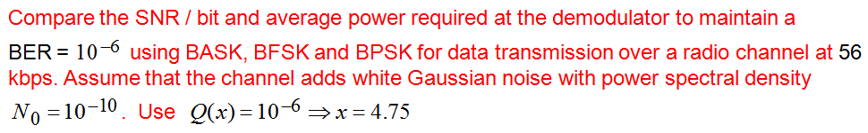

Slide 15
Quaternary Phase-Shift Keying (Quadriphase-shift Keying ) QPSK
Quaternary phase shift keying (QPSK), or quadrature PSK as it is sometimes called, is another form of angle-modulated, constant-amplitude digital modulation.
QPSK is an M-ary encoding scheme where N = 2 and M = 4 (hence, the name “quaternary” meaning “4”).
With QPSK, four output phases are possible for a single carrier frequency. Because there are four output phases, there must be four different input conditions.
With two bits, there are four possible conditions: 00, 01, 10, and 11.
Therefore, with QPSK, the binary input data are combined into groups of two bits, called dibits.
In the modulator, each dibit code generates one of the four possible output phases (45°, 135°, 45°, and 135°).

Slide 16
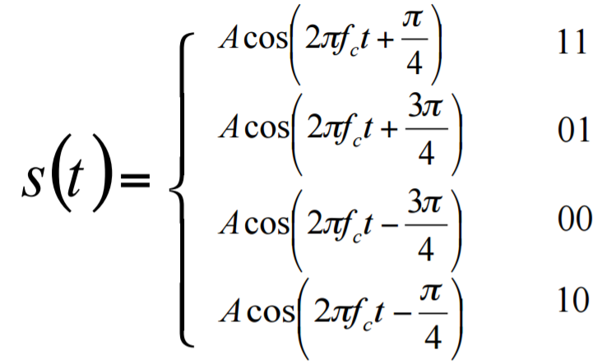

Slide 17
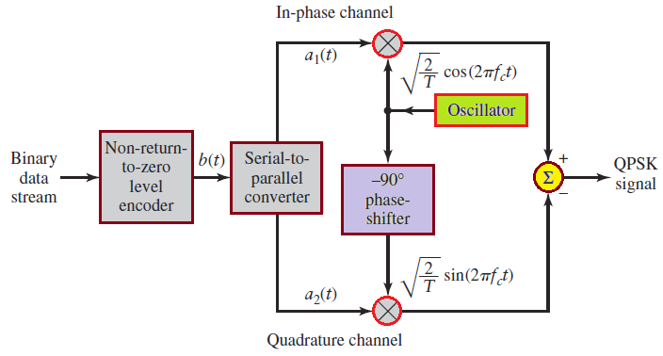
QPSK Modulator

Slide 18
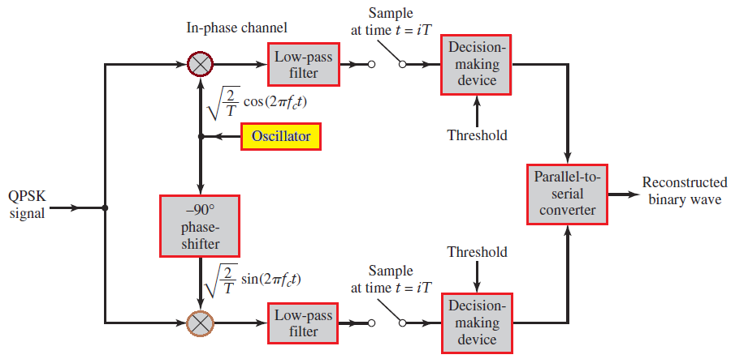
Receiver

Slide 19
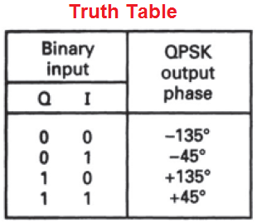
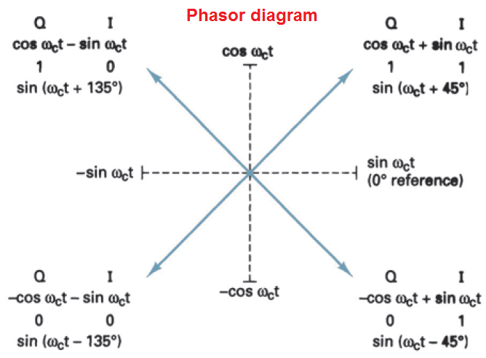

Slide 20
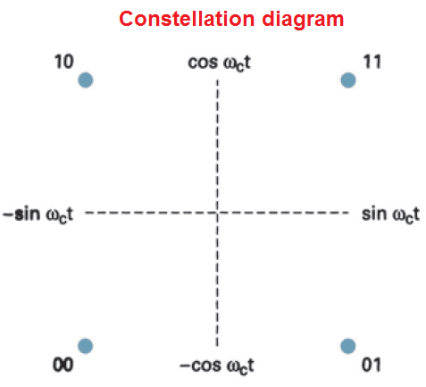

Slide 21
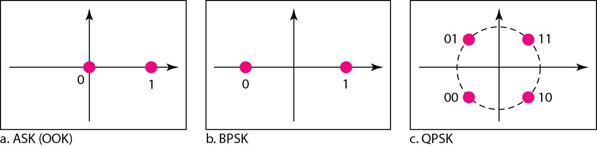
The constellation diagrams for an ASK (OOK), BPSK, and QPSK signals.

Slide 22
End

